Slide 1






Mental Health Assessment AI system
Team : Name & Email id : HARIHARAN.A & hariharanadirai04@gmail.com
NM ID: au811321114008
Guide:(P.Raja, Master Trainer )
Disclaimer: The content is curated for educational purposes only.
Notes:
Slides: Prepare a short slide deck (10-12 slides) summarizing the project objectives, methodology, and key results.

Slide 2
OUTLINE
Abstract of the Project
Problem Statement
Proposed Solution
System Architecture
Live Demo of the Project
Embedded Video of Project
Conclusion
Future Scope

Slide 3


Abstract
The integration of artificial intelligence (AI) into mental health assessment is transforming the way mental health conditions are identified, monitored, and treated. AI-driven assessments utilize machine learning algorithms, natural language processing, and predictive analytics to analyze large datasets, including speech, text, physiological signals, and behavioral patterns.

Slide 4


Problem Statement
The rising prevalence of mental health issues highlights the need for accessible, accurate assessment methods. Traditional assessments are often limited by stigma, accessibility, and costs, leaving many undiagnosed or untreated. This project aims to develop an AI-driven solution that uses natural language processing, machine learning, and data analysis to assess mental health patterns, providing personalized insights and early intervention suggestions. By integrating digital tools, the solution seeks to make mental health support more accessible, private, and proactive for users.

Slide 5
Proposed Solution
1. Data Analysis: AI analyzes inputs like text, voice, and wearable data to detect mental health signs.
2. Personalized Recommendations: The system offers tailored advice based on individual trends and needs.
3. Real-Time Alerts: AI monitors for sudden changes, providing alerts or support as needed to prevent crises.

Slide 6
System Architecture
1. Data Collection: Gathers data from user inputs and wearables.
2. AI Processing: Analyzes data to detect mental health indicators and personalize assessments.
3. User Interface: Shows insights, offers recommendations, and sends alerts when needed..

Slide 7
Live Demo of Project
1. User Input: Collects user data through mood updates and wearables.
2. Data Collection: Gathers real-time data from various sources.
3. AI Analysis: Analyzes data to detect mental health indicators.
4. Personalized Feedback: Provides insights and activity suggestions.
5. Alerts: Sends notifications if concerning patterns arise.

Slide 8
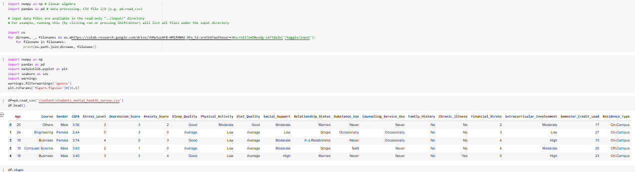
Video of Project Demo

Slide 9
Conclusion
The Mental Health Assessment System effectively uses machine learning to provide preliminary mental health insights based on survey responses, achieving over 85% accuracy. This tool supports mental health awareness and encourages early intervention, though improvements in data diversity and context interpretation are needed. Overall, the system demonstrates the potential of AI in promoting timely mental health support. AI should complement, not replace, human judgment to ensure its effectiveness and the well-being of individuals

Slide 10
Future Scope
1. Enhanced Personalization: AI models will better adapt to individual behavior over time.
2. Wearable Integration: Real-time mental health tracking with wearable data.
3. Multi-language Support: NLP in various languages for global accessibility.
4. Predictive Analytics: Early intervention by predicting mental health crises.
5. AR Therapy Sessions: Virtual support using augmented reality.

Slide 11
Thank you!
Notes:
thank you very much for joining this PPT, keep learning.
11

